Slide 1
AI
Artificial Intelligence (AI) refers to the simulation of human intelligence in machines that are programmed to think, learn, and make decisions like humans.
AI encompasses a wide range of technologies, including machine learning, natural language processing, robotics, and computer vision.
Key Components of AI
Machine Learning (ML): A subset of AI that involves training algorithms to make predictions or decisions based on data. Examples include recommendation systems and spam filters.
Natural Language Processing (NLP): Enables machines to understand and interpret human language. Examples include chatbots and virtual assistants.
Computer Vision: Allows machines to interpret and make decisions based on visual data. Examples include self-driving cars and facial recognition systems.
Robotics: Involves the design and use of robots to perform tasks. Examples include manufacturing robots and robotic surgery.

Slide 2
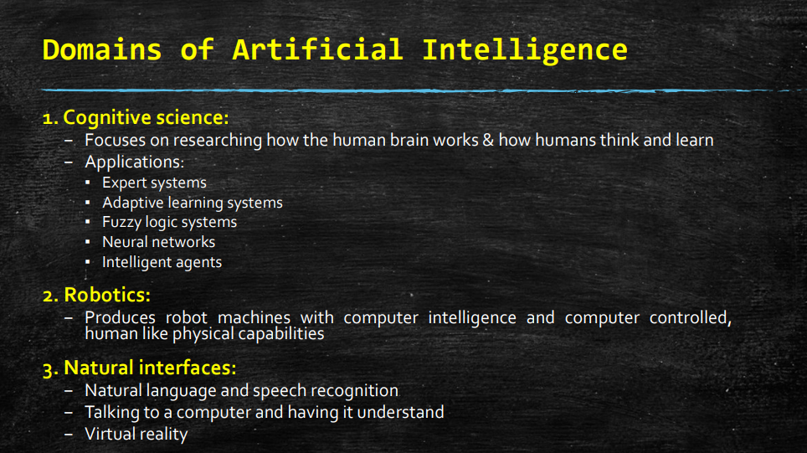

Slide 3
Neural Network
A neural network is a fundamental concept in artificial intelligence and machine learning, inspired by the biological neural networks in the human brain.
It consists of interconnected nodes (neurons) organized in layers that process information and learn from data to make decisions or predictions.
Neurons and Layers:
Neurons: Individual units that receive input, process it using an activation function, and pass on the output to the next layer.
Layers: Neurons are organized into layers—typically input, hidden, and output layers—that collectively transform input data into meaningful output.
Weights and Bias:
Weights: Each connection between neurons has a weight that determines the strength of influence one neuron has on another.
Bias: An additional parameter added to the neurons that allows adjusting the output along with the weighted sum of inputs.

Slide 4
Neural Network
3. Activation Function:
Determines the output of a neuron. Common activation functions include sigmoid, tanh, and ReLU (Rectified Linear Unit).
4. Training and Learning:
Forward Propagation: Process of passing input data through the network to compute output.
Backpropagation: Adjusting weights and biases during training based on error (difference between predicted and actual output) to minimize the error using optimization algorithms like gradient descent.

Slide 5
Example of Neural Network: Handwritten Digit Recognition
Scenario: Training a neural network to recognize handwritten digits (0-9) based on images.
How It Works:
Input Layer:
Description: Consists of neurons where each neuron represents a pixel value in the input image (e.g., 28x28 pixels for MNIST dataset).
Example: Inputting grayscale images of handwritten digits.
Hidden Layers:
Description: Layers between input and output layers where neurons process input data using weights and activation functions to extract features.
Example: Multiple hidden layers with hundreds of neurons each, applying weights and biases to transform input data.
Output Layer:
Description: Neurons in this layer produce the final output, representing the predicted digit (0-9).
Example: 10 neurons (one for each digit), each neuron outputting a probability score using softmax activation function.
Training Process:
Forward Propagation: Input image data passes through the network, computing outputs.
Backpropagation: Computes error (difference between predicted and actual digit) and adjusts weights and biases using gradient descent to minimize error.
Testing and Inference:
Description: Once trained, the neural network can classify new, unseen images of handwritten digits.
Example: Inputting a new handwritten digit image, the network predicts the digit based on learned patterns and weights.

Slide 6
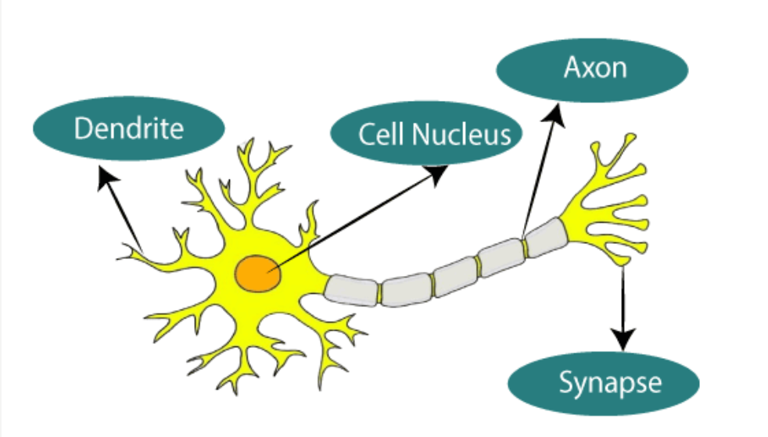

Slide 7
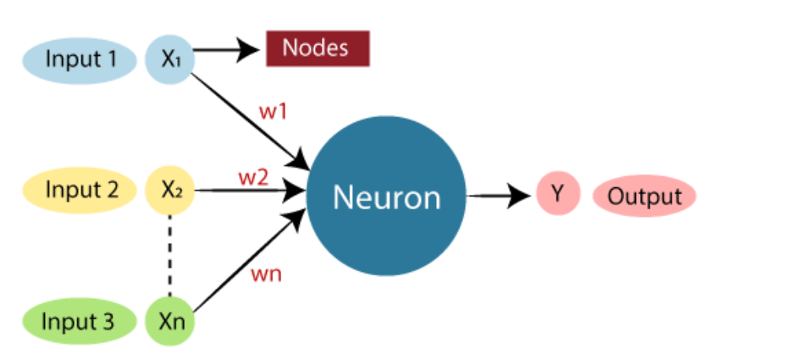

Slide 8
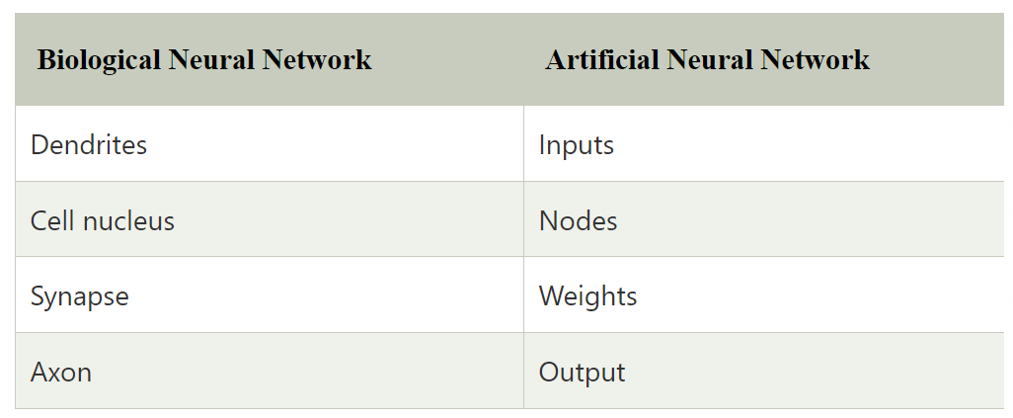

Slide 9
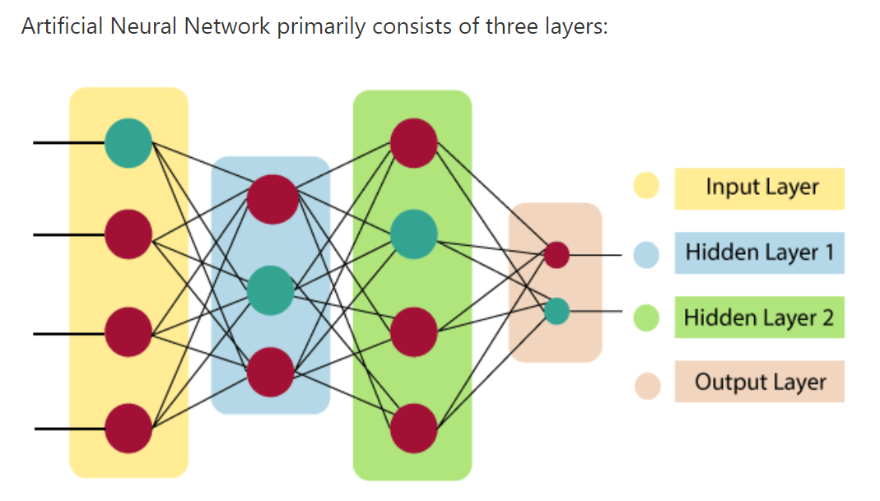

Slide 10


Slide 11
Virtual Reality
Virtual Reality (VR) is a technology that creates a simulated environment or experience, often using computer-generated content and sensory inputs such as sight, sound, and sometimes even touch.
Users can interact with and immerse themselves in this artificial environment, typically through specialized VR headsets or goggles
How Virtual Reality Works
Creation of Virtual Environment: Virtual reality begins with creating a digital simulation of an environment using computer-generated imagery (CGI) or 360-degree video.
Sensory Inputs: VR headsets provide visual and auditory inputs to users, presenting them with a 3D visual and spatial audio experience that mimics real-world perception.
Interaction and Immersion: Users can interact with the virtual environment through gestures, movements, and sometimes voice commands, enhancing the feeling of presence and immersion.
Real-Time Rendering: Advanced graphics rendering techniques ensure that changes in the user’s perspective or movements are reflected in real-time within the virtual environment.

Slide 12
Application
Gaming and Entertainment
VR gaming offers immersive experiences where players can explore virtual worlds, interact with characters, and engage in simulated activities.
Training and Simulation
Industries use VR for training simulations in fields such as aviation, medicine, military, and manufacturing to practice skills in a safe, controlled environment.
Education and Research
VR is used in education to provide interactive learning experiences, virtual field trips, and simulations that enhance understanding of complex concepts.
Healthcare and Therapy
VR is used for pain management, exposure therapy for phobias, rehabilitation exercises, and mental health treatments.
Architecture and Design
Architects and designers use VR to visualize and explore 3D models of buildings and environments before construction, improving design accuracy and client communicatio

Slide 13
Components
Headset or Goggles
Description: VR headsets are the primary hardware used to experience virtual reality. They typically consist of a head-mounted display (HMD) with lenses that display virtual environments to the user.
Example: Oculus Rift, HTC Vive, PlayStation VR are popular VR headsets.
Motion Tracking Sensors
Description: Sensors track the user's head and body movements to update the view accordingly, creating a sense of immersion and realism.
Example: External sensors or cameras track the position and orientation of the user in physical space.
Graphics Rendering
Description: Powerful computers or gaming consoles render high-quality graphics in real-time to create realistic virtual environments.
Example: GPUs (Graphics Processing Units) in computers or gaming consoles like PlayStation 5 or Xbox Series X render VR content.
Audio Output
Description: VR systems provide spatial audio to simulate sound coming from different directions in the virtual environment, enhancing immersion.
Example: Headphones integrated into the VR headset or external surround sound systems.
Input Devices
Description: Controllers or gloves allow users to interact with objects and navigate within the virtual environment.
Example: Oculus Touch controllers, HTC Vive controllers, or haptic gloves for tactile feedback.

Slide 14
Intelligent agent
An intelligent agent is a software entity that perceives its environment through sensors and acts upon it using actuators based on predefined goals or objectives. These agents are integral to artificial intelligence systems and can range from simple reactive agents to complex, autonomous entities capable of learning and reasoning. Here’s an explanation of intelligent agents along with their types and examples:
Intelligent Agent Explanation
Perception: Agents perceive their environment through sensors, which capture data about the state of the environment or user interactions.
Reasoning: Agents make decisions or take actions based on their internal knowledge, goals, and the information gathered from the environment.
Actuation: Agents act upon the environment using actuators, such as motors, displays, or output devices, to achieve their goals.

Slide 15
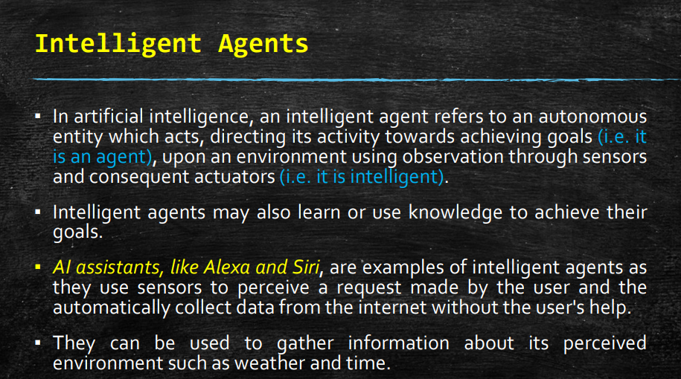

Slide 16
Types of Intelligent agent
Types of Intelligent Agents
Simple Reflex Agents
Description: React to the current state of the environment without considering past states or future consequences.
Example: A thermostat that turns on the heating when the temperature drops below a certain threshold.
Model-Based Reflex Agents
Description: Maintain an internal model of the environment to make decisions based on past and current states.
Example: A chess-playing agent that evaluates board positions and predicts opponent moves based on known strategies.
Goal-Based Agents
Description: Pursue specific goals or objectives defined by the user or programmer.
Example: An autonomous delivery robot navigating through a warehouse to deliver packages efficiently while avoiding obstacles.
Utility-Based Agents
Description: Make decisions based on maximizing or minimizing a utility function that evaluates the desirability of outcomes.
Example: A stock trading agent that buys and sells stocks based on expected returns and risk levels calculated from market data.
Learning Agents
Description: Improve performance over time by learning from past experiences and interactions with the environment.
Example: An adaptive game-playing agent that learns strategies from playing against itself or human opponents.
Belief-Desire-Intention (BDI) Agents
Description: Model human-like reasoning by maintaining beliefs about the world, desires or goals to be achieved, and intentions or plans to achieve those goals.
Example: A personal assistant agent that understands user preferences, schedules, and tasks to provide timely reminders and assistance.

Slide 17
Data mining
Description: Data mining is the process of discovering patterns, anomalies, correlations, and trends within large datasets to extract useful information. It involves various techniques from machine learning, statistics, and database systems to uncover hidden patterns and relationships that can help businesses make informed decisions.
Example:
Market Basket Analysis: Analyzing customer purchase data to discover associations between products often bought together, which can inform marketing strategies and product placements in retail stores.
Customer Segmentation: Using clustering algorithms to group customers based on purchasing behavior, demographics, or preferences, aiding in targeted marketing campaigns.

Slide 18
Data warehousing
Description: Data warehousing involves the process of collecting, storing, and organizing data from multiple sources into a centralized repository, typically optimized for analytical reporting and decision-making.
Example:
Enterprise Data Warehouse (EDW): A centralized database that integrates data from various operational systems (like OLTP systems) across an organization. It allows for historical analysis and provides a single source of truth for business reporting and analytics.

Slide 19
OLTP
OLTP (Online Transaction Processing)
Description: OLTP systems are designed for transaction-oriented applications where data is frequently updated and queried in real-time. They ensure data integrity and support day-to-day operations of an organization.
Example:
E-commerce Transactions: Processing online orders, updating inventory levels, and handling customer interactions in real-time.
Banking Transactions: Managing withdrawals, deposits, and transfers in banking systems.

Slide 20
OLAP
OLAP (Online Analytical Processing)
Description: OLAP involves querying and analyzing multidimensional data from data warehouses to support complex analytical queries, reporting, and business intelligence (BI).
Example:
Sales Analysis: Summarizing sales data across different regions, products, and time periods to identify trends and opportunities.
Financial Reporting: Generating quarterly or annual reports that consolidate financial data from various departments or subsidiaries for analysis and decision-making.

Slide 21
OLTP VS OLAP
Key Differences:
Purpose: OLTP systems focus on transaction processing and maintaining data integrity in real-time, while OLAP systems are geared towards analytical queries and reporting.
Data Structure: OLTP systems typically have normalized data structures to minimize redundancy and ensure efficient transaction processing, whereas OLAP systems use denormalized or star/snowflake schema structures optimized for complex queries.
User Interaction: OLTP systems are used by operational staff for daily transactional activities, while OLAP systems are accessed by analysts, managers, and executives for strategic decision-making and business intelligence.

Slide 22
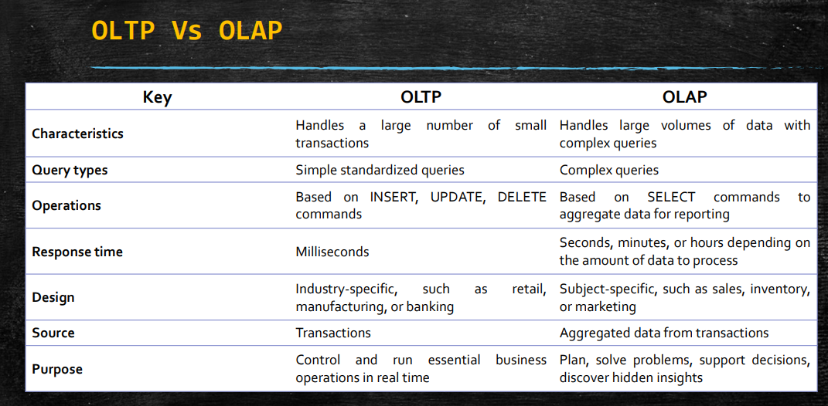

Slide 23
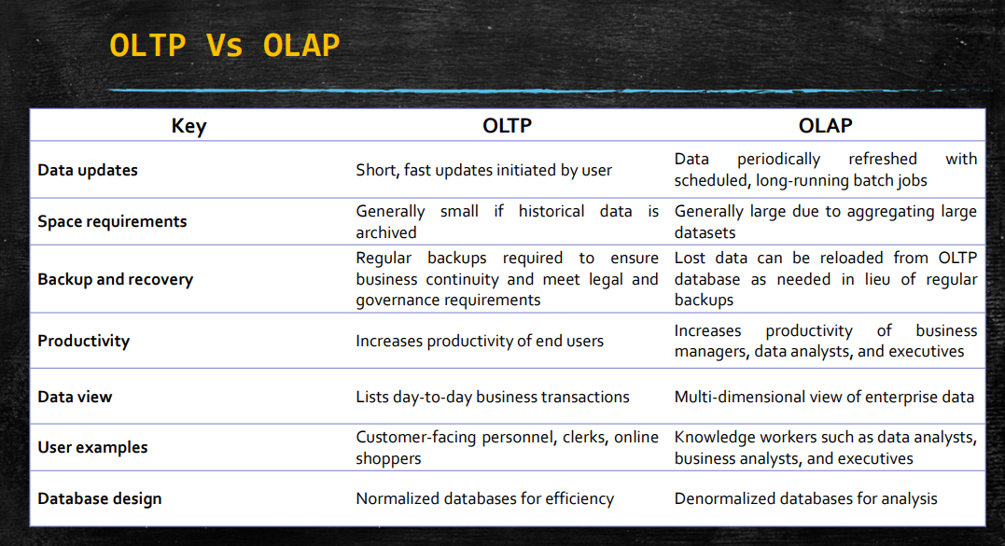

Slide 24
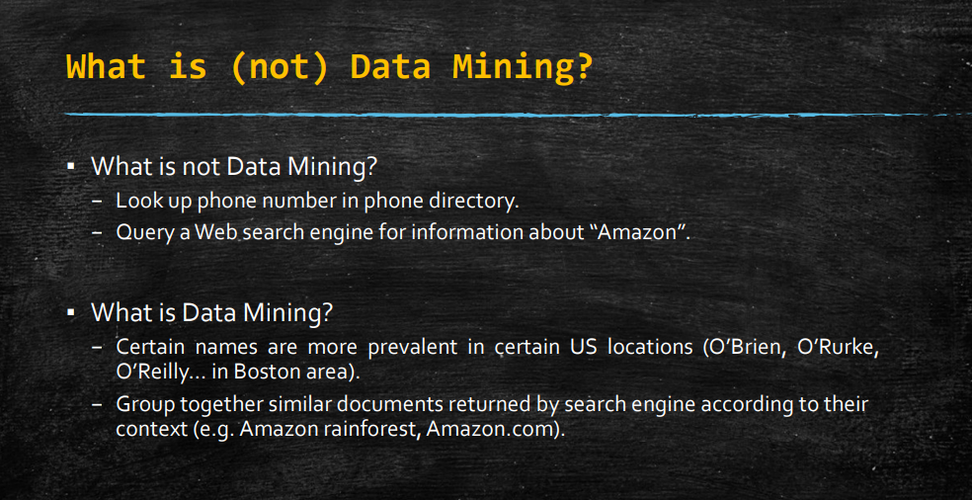

Slide 25
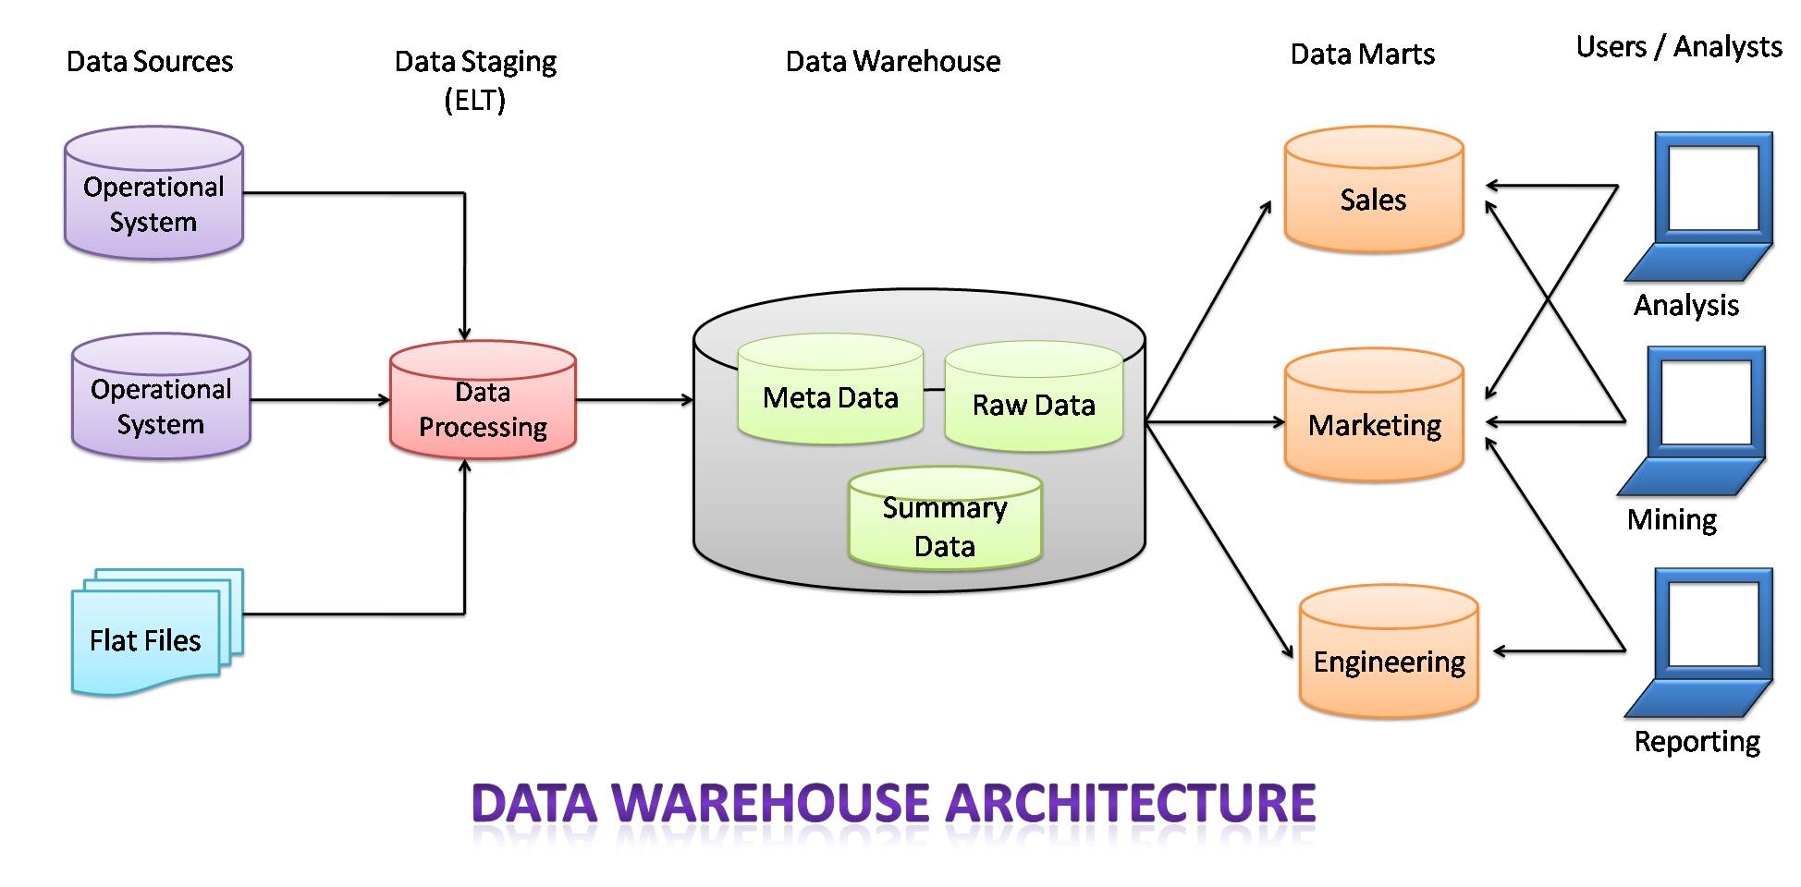

Slide 26
Anomaly Detection
Anomaly detection involves identifying data points that deviate from normal patterns or behaviors within a dataset.
It typically relies on statistical methods, machine learning algorithms, or domain-specific rules to distinguish between normal and abnormal data points.
The goal is to flag unusual instances that warrant further investigation or action.
Example of Anomaly Detection
Scenario: Monitoring network traffic for cybersecurity threats.
Description: An organization monitors its network traffic to detect potential cyber attacks or abnormal behavior that could indicate security breaches. Anomaly detection techniques are applied to identify unusual patterns in network activity that deviate from expected norms.

Slide 27
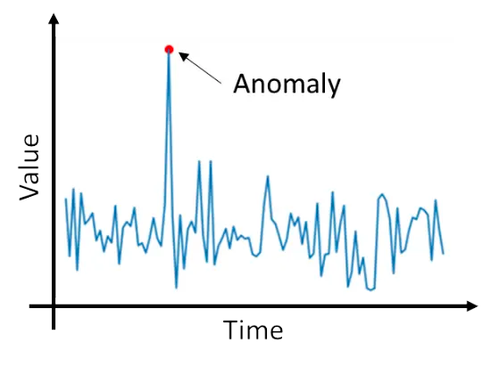
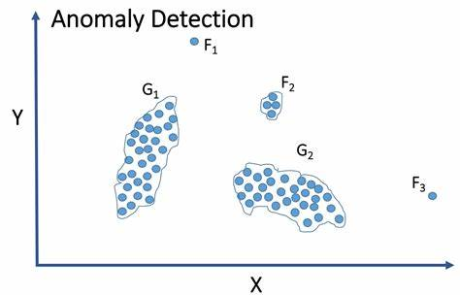

Slide 28
Benefits of Anomaly Detection
Early Detection: Helps in identifying abnormal behavior before it causes significant damage or disruption.
Enhanced Security: Improves cybersecurity measures by proactively identifying potential threats and vulnerabilities.
Operational Efficiency: Reduces false positives and focuses resources on investigating genuine security incidents.
Insight Generation: Provides insights into data patterns and trends that may indicate emerging risks or operational inefficiencies.

Slide 29
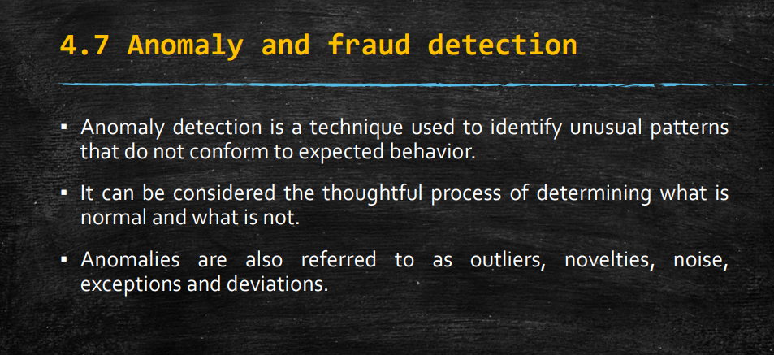

Slide 30
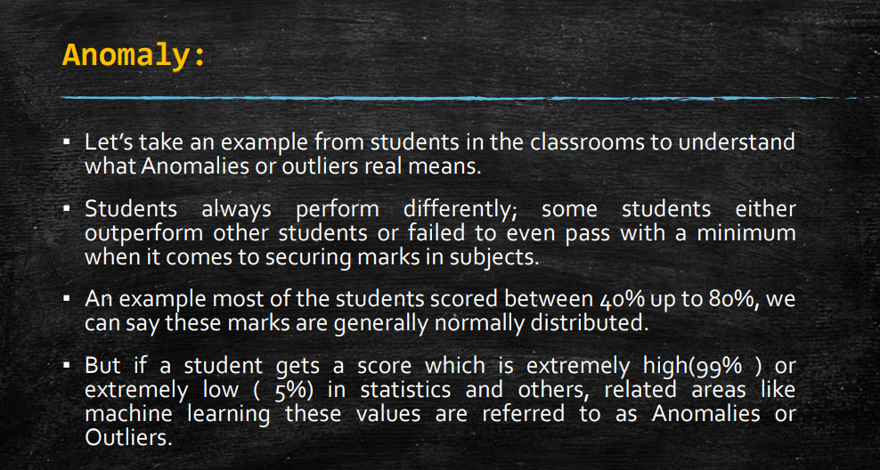

Slide 31
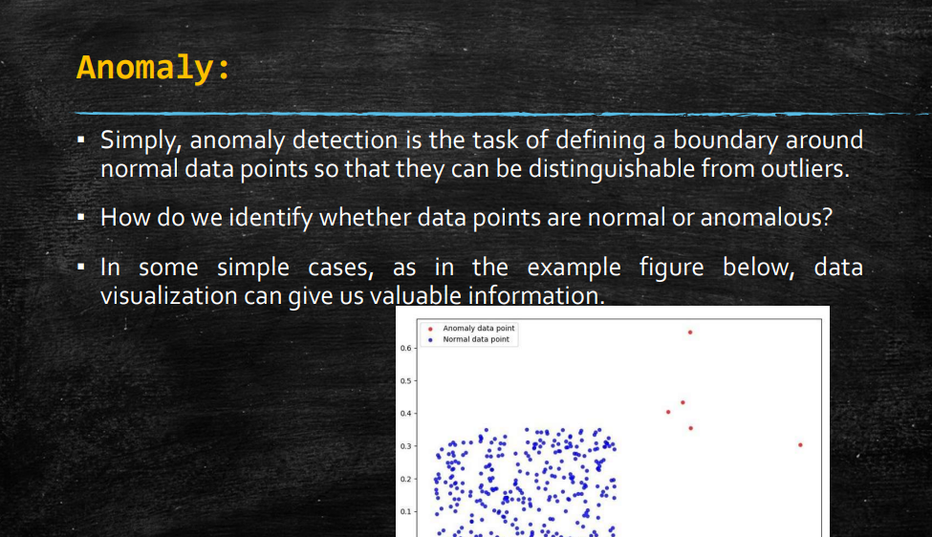

Slide 32
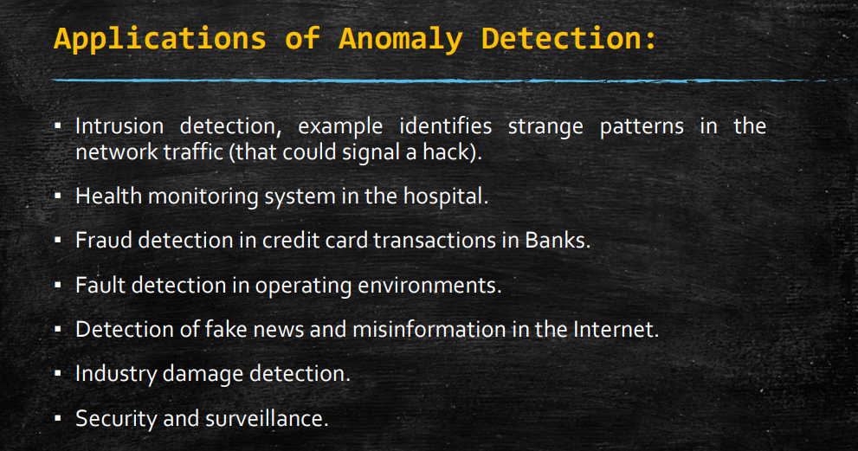

Slide 33
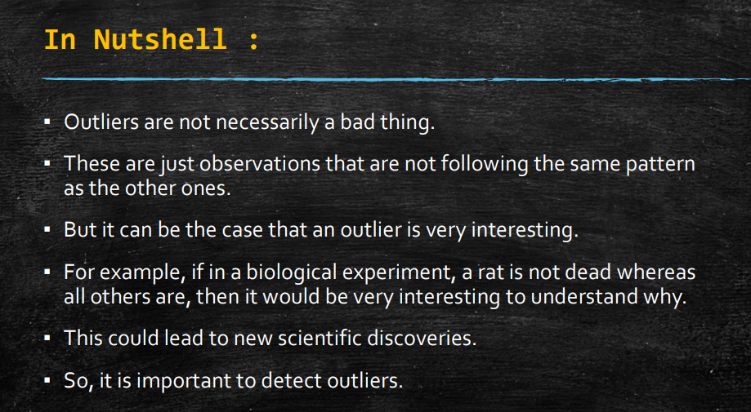

Slide 34
Fraud
Fraud is a deliberate deception or misrepresentation that results in unauthorized benefit, often financial, to the perpetrator at the expense of another party. It involves dishonesty, deceit, or trickery with the intent to gain an unfair or unlawful advantage.
Characteristics of Fraud:
Intent: Fraud involves intentional actions or omissions aimed at deceiving others.
Deception: It typically includes misleading or concealing information to create a false impression.
Financial or Material Gain: The primary motive behind fraud is usually to obtain financial benefits, assets, or advantages.

Slide 35
Fraud
Types of Fraud:
Financial Fraud: Manipulation of financial records, misrepresentation of financial statements, or theft of funds.
Insurance Fraud: Falsifying claims or exaggerating losses to obtain insurance payouts.
Identity Theft: Using someone else's personal information without authorization for fraudulent purposes.
Credit Card Fraud: Unauthorized use of credit card information to make purchases or withdraw funds.
Corporate Fraud: Misappropriation of company assets, insider trading, or falsifying financial reports.
Internet Fraud: Scams or schemes conducted online, such as phishing, fake websites, or fraudulent investments.

Slide 36
Fraud
Detection and Prevention:
Internal Controls: Implementing checks and balances to detect and deter fraudulent activities within organizations.
Audits and Monitoring: Regular audits and monitoring of financial transactions, accounts, and processes to identify anomalies or suspicious activities.
Employee Training: Educating employees on fraud awareness, ethical behavior, and reporting mechanisms.
Technology Solutions: Utilizing advanced analytics, machine learning, and AI-driven tools for real-time detection of fraudulent patterns and behaviors.

Slide 37
Fraud Detection
Fraud detection is a specialized application of data analytics and machine learning aimed at identifying and preventing fraudulent activities within various domains such as finance, e-commerce, healthcare, and insurance.
The goal is to distinguish between legitimate transactions or activities and those that are fraudulent or suspicious.
Fraud detection involves using data-driven techniques to uncover patterns, anomalies, or indicators of fraudulent behavior within large datasets.
It typically employs advanced algorithms and statistical methods to analyze transactional data, user behaviors, or other relevant information to detect potentially fraudulent activities.

Slide 38
Example
Scenario: Credit card fraud detection in banking.
Description: Banks use fraud detection systems to monitor credit card transactions in real-time. Here’s how it works:
Data Collection: Collect transaction data including cardholder information, transaction amounts, merchants, timestamps, etc.
Preprocessing and Feature Engineering: Clean and preprocess data, extract features like transaction frequency, unusual spending patterns, location consistency, etc.
Model Development: Train a machine learning model (e.g., random forest classifier) on labeled data where fraud cases are identified.
Real-Time Monitoring: Monitor incoming transactions in real-time, scoring each transaction based on the trained model.
Alerting and Response: Flag transactions with high fraud probability, triggering alerts for immediate review by fraud analysts.
Post-Detection Analysis: Investigate flagged transactions, confirm fraudulent activities, and take actions such as blocking cards or contacting customers.

Slide 39


Slide 40
